Slide 1
Speed as An Input Channel
• Introduction
Provides an introduction to the thesis and outlines its objectives.
• Background
Offers background information on the project and reviews previous works related to the thesis.
• Data Collection
Presents previous work with similar aims, discusses modifications made to these works, and outlines the data collection process.
• Algorithm
Discusses and explains the algorithm employed in the project to detect user speed based on mouse cursor movement.
• Code Explanation
Summarizes and explain the functions for every class in the project.
• Conclusion and Future Work
Concludes the project, summarizes findings, and outlines future steps and improvements needed in the HCI field.

Slide 2
Introduction Motivation
Understanding User Needs
User interface designers strive to meet evolving user needs, which vary over time.
The Human-Computer Interaction (HCI) field addresses the challenge of catering to user preferences when dealing with computer-related tasks.
HCI facilitates a comprehensive understanding of the human brain, the primary constraint for designers in creating applications or software.
Leveraging both physical and mental capabilities allows designers to enhance and develop more suitable interfaces.
Importance of Speed
Speed is a critical factor in user interface design, measuring how quickly the computer responds to user input.
In a 2009 study by Turkish and American HCI researchers Seneler, Basoglu, and Daim, 54.9% of participants preferred speed over other features like Adaptive Behavior, Content Density, Customization, and Minimal Memory Load.
Speed is pivotal in creating an effective user interface, as demonstrated by user preferences.

Slide 3
Introduction Aim of the Project
User Speed Detection
The project aims to investigate whether software can detect the user's speed based on mouse cursor movement data.
If proven successful, this concept could significantly contribute to advancing the HCI field, introducing speed as a valuable input for future software designs.
The software would be designed to perform actions in response to the detected user speed, opening new possibilities for user interaction.

Slide 4
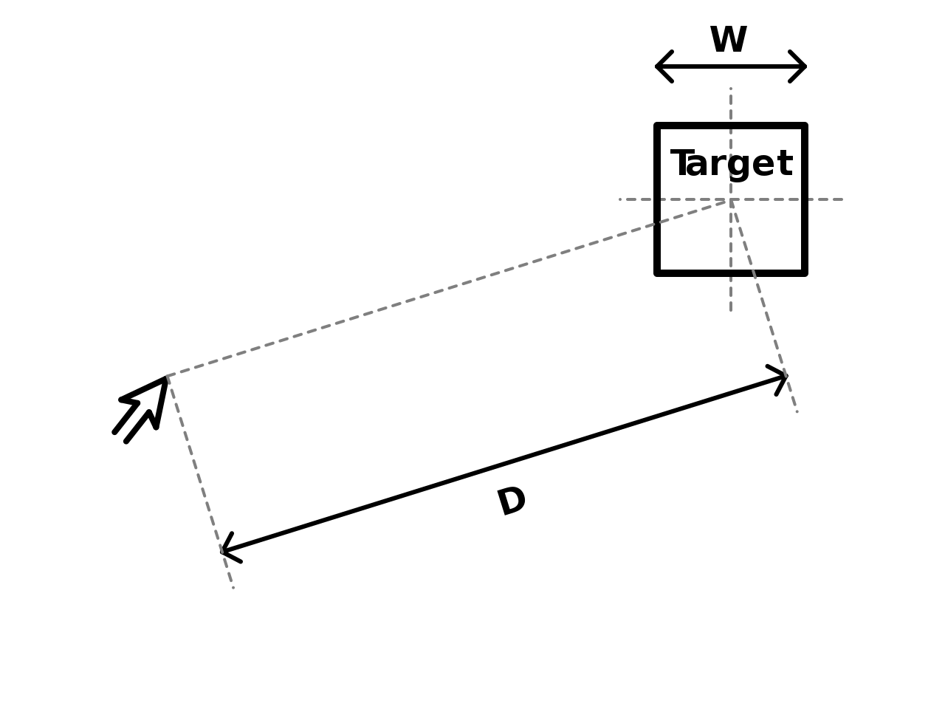
Background
Fitts' Law
Predictive Model
• Fitts' law is a predictive model in Human-Computer Interaction, named after Paul Fitts.
• It predicts the time required for rapid pointing, either physically or virtually using pointing devices like a mouse cursor.
• The formula involves constants a, b, and c , representing device-specific factors, movement distance (A), and target width (W), respectively.
T= a + blog₂( (A÷W) + c)

Slide 5
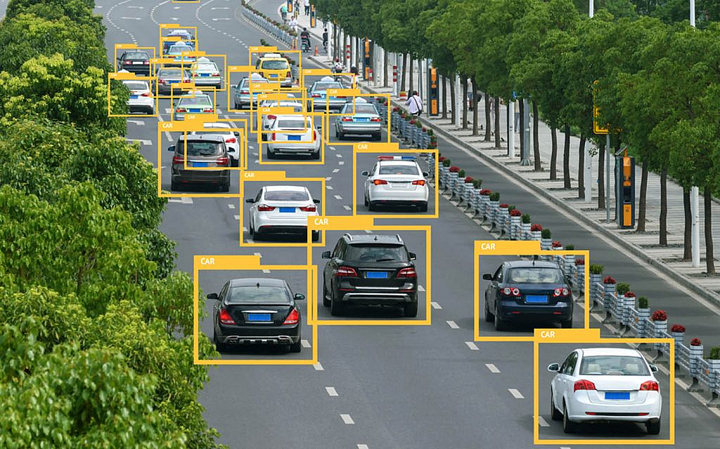
Background
Artificial Intelligence
Machine Learning
Machine learning, a subset of artificial intelligence, uses algorithms to predict outcomes based on collected data.
The project employs machine learning algorithms, specifically Decision Tree and Extra Tree.
Identifying Cars in an image

Slide 6
Background
Acquisition of Expanding Targets
Fitts' Law in Software Design
• Today's software, like Apple MacBook, utilizes Fitts' law in designing targeting icons.
• McGuffin & Balakrishnan investigated factors influencing expanding targets acquisition, experimenting with different expansion conditions (Static, Spatial, Fading-in).

Slide 7
Background
Facilitating Moving Targets Acquisition on Augmented Reality Devices
Target Width in Motion
Fitts' law depends on target width; however, moving targets pose a challenge.
Chuang-Wen You, Yung-Huan Hsieh, and Wen-Huang Cheng introduced the AttachedShock technique, utilizing wave propagation to increase target width, aiding in target selection on augmented reality devices.

Slide 8
Background
How Low Can You Go
Mouse Sensor Resolution
Mouse sensor resolution is increasing, raising questions about user control over small movements.
Aceitunol, Casiez, and Roussel's experiment determined the reliable resolution of a mouse sensor, emphasizing the threshold for accepted small displacements, it resulted on 95% as the threshold for the accepted production of a small displacements and show that the reliable resolution is between 200 and 400 CPI.

Slide 9
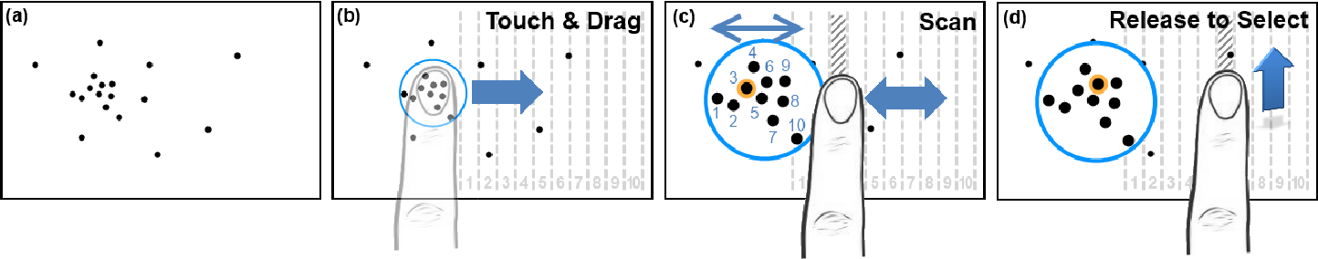
Background
LinearDragger
Improving Touch Input Precision
• LinearDragger is a one-finger target technique designed to enhance touch input precision for small and clustered targets.
• An experiment by Au, Su, and Lau demonstrated the conversion of selecting 2D targets into a simplified 1D problem through touch-drag-release operations.
LinearDragger Process

Slide 10
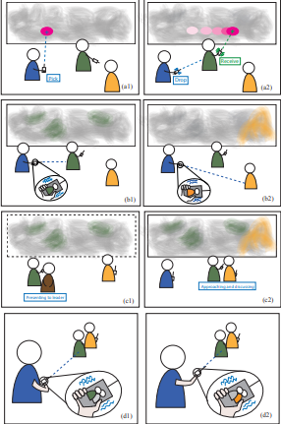
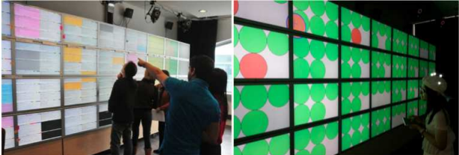
Background
Leveraging Physical Human Actions in Large Interaction Spaces
Gestural Interaction for Data Exchange
• Liu's research explores a technique leveraging gestural interaction between users to support simultaneous navigation and data manipulation.
• The PoPle Prototype demonstrates the effectiveness of wall-sized displays for collaborative interactions, emphasizing the importance of high-resolution displays over desktop screens
PoPle Prototype Example
Wall-Sized Display that are used in the experiment

Slide 11
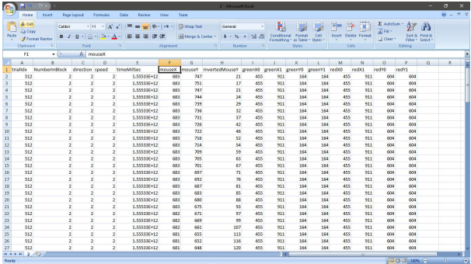
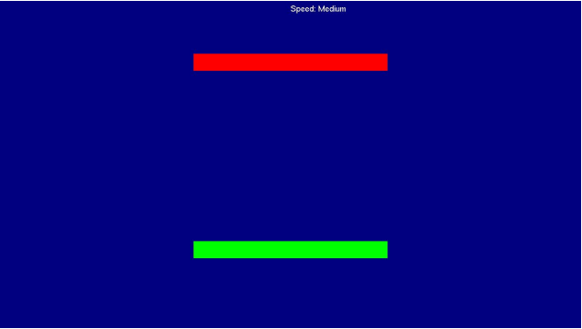
Data Collection
Previous Approach
ISpeed Project
• Ibrahim El Seoud conducted a previous experiment categorized into slow, medium, and fast speeds.
• The experiment involved participants moving the mouse cursor between green and red lines in four directions.
• Detailed data, including trial number, direction, speed, time taken, mouse position, and line coordinates, was recorded in CSV files.
• Abdelrahman Moghazy developed a Python algorithm to calculate speed, and the Extra Trees algorithm was used for data analysis.
CSV datafile
Green line and Red line window with speed at the top of the window

Slide 12
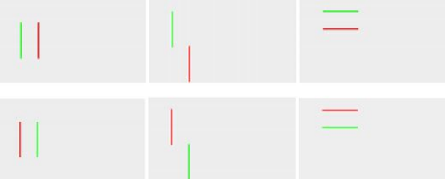
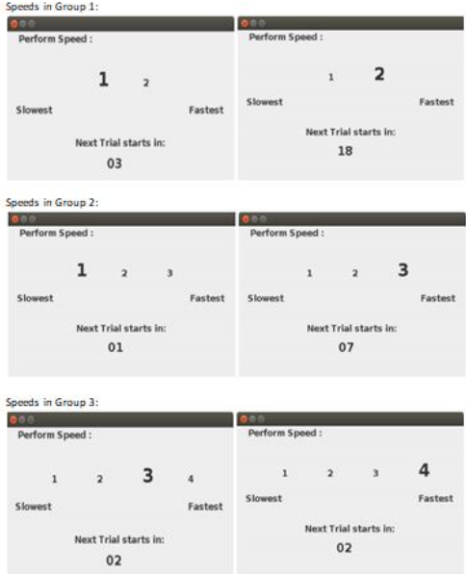
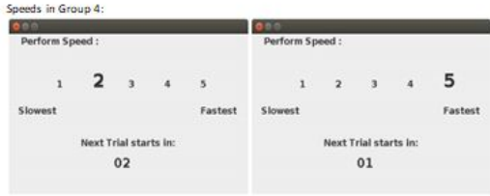
Data Collection
Enhanced Directory Navigation
• Salman K. ElDash's experiment focused on measuring mouse speed crossing a line under 6 different orientations (right to left, left to right, up to down, down to up, up-left to down-right, down-right to up-left).
• Distances were varied (short, medium, large), and participants were divided into 4 groups. tested 2 to 5 speeds.
The six orientation
Speed Group 1,2,3
Speed Group 4

Slide 13
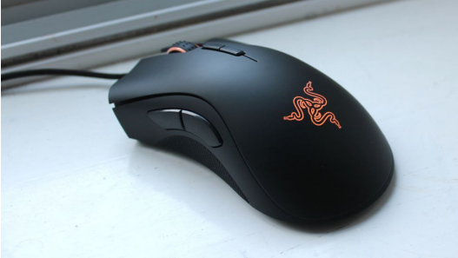
Data Collection
Modifications
ISpeed Project Updates
• To enhance accuracy, a very slow speed was added, resulting in four categorized speeds: Very Slow, Slow, Fast, and Very Fast.
• The total number of trials increased to 1440, with 90 trials for each speed in one direction (4 speeds and 4 directions).
Performance
Experiment Setting
• Conducted on 8 university students (2 males, 6 females) aged between 19 and 22 years old.
• Silent university room setting to minimize interruptions.
• Participants used a Razor DeathAdder Elite mouse with a 5G sensor (optical sensor technology, which is often measured in dots per inch ) , capable of handling accelerations up to 50 GF (it can respond to rapid movements and changes in speed ) and accurate tracking at 450 inches per second.
Results
• Each participant took between 2 to 2.5 hours to complete the experiment.
• All participants were aware of the experiment, and none reported difficulties.
• The collected data for each participant was stored in CSV files
Razor DeathAdder Elite

Slide 14
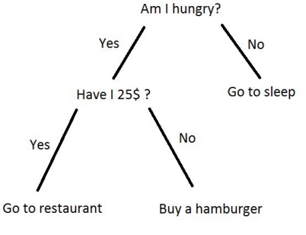
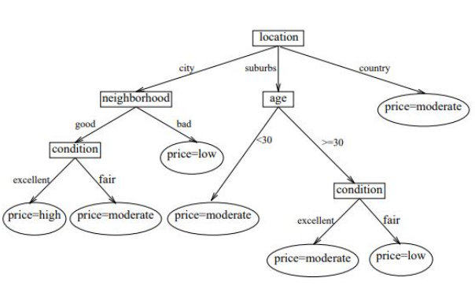
Algorithm Decision Tree
Decision Tree in Supervised Machine Learning
• Decision trees are a type of supervised machine learning algorithm.
• They form tree-like graphs to predict outcomes based on input data.
• Each branch represents an outcome of a test, and each leaf node represents a class label.
Decision Tree Structure
• The tree continuously splits data based on questions derived from the training data.
• Paths from the root to leaves symbolize classification rules.
• Each leaf node is a result of a decision rule.
Decision Rule and Examples
• Decision rules are conditional statements that classify data into query cases.
Advantages of Decision Trees
• Decision trees are easy to understand and interpret.
They offer value even with complex data, providing insights through expert input.
• Decision trees can handle all cases, determine best and worst scenarios, and be combined with other techniques.

Slide 15
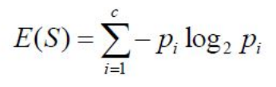
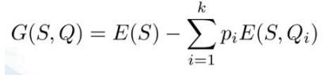
Algorithm Entropy and Information Gain
• Entropy measures the similarity of data in decision trees.
• High entropy means less conclusive information from the data.
• Formula represents entropy calculation.
• Information Gain is vital in constructing decision trees.
• It measures how much information a class provides.
• The formula includes entropy of the parent node E(S) and entropy of divided nodes E(S,Qi) ,and k is total number of the divided nodes.
c represents total number of classified group of the original data. the pi represent the probability of the number of the classified group over the original data.
The result of this entropy calculation is always non-negative, as each term in the summation is non-negative. The negative sign is there to ensure that the entropy is a positive quantity that increases as the impurity or disorder in the set increases.

Slide 16
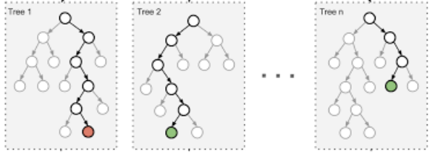
Algorithm Extra Trees
Extra Trees in Ensemble Learning
• Extra Trees, or Extremely Randomized Trees, is an ensemble learning method.
• It constructs multiple decision trees during training.
• It runs random decision trees and mitigates overfitting.
Advantages of Extra Trees
• Extra Trees reduces overfitting by using multiple decision trees.
• It performs well on large datasets and provides high accuracy.
• Extra Trees can estimate missing data and continue functioning.
Extra Tree Diagram

Slide 17
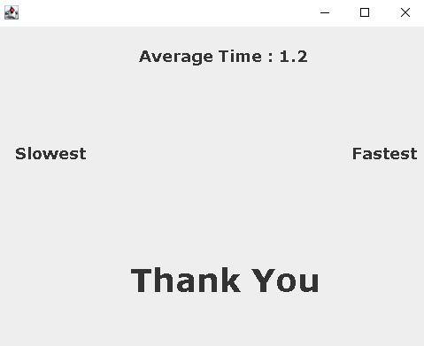
Code Explanation
Classes that are implemented are:
• Experiment: The class where the experiment is simulated
• PartInfo: the class where the data of the participant is stored in
• Trial: the class that deals with configuration files
• StartTrial: the class that calls a new Frame (Experiment static variable) when a trial is finished
• Frame: the class that contains two components (Red and green) with their respective mouse listener events in a declared frame and handles the speed calculation.
• Stopwatch: a timer class used to calculate time taken for the mouse to propagate from the green to the red line
• EndExp: A thank you message left at the end
• Configuration file : The file that contains all the required trials a participant must do

Slide 18
Code Explanation Experiment Class
1.Intialization
public static Frame block = null;
Purpose: Represents a static variable for the Frame class used in the experiment.
Implementation :
• Frame is a class that represents a frame in a graphical user interface (GUI).
• This static variable is used to track the current frame in the experiment.
• Initialized as null.
public static int counter = 1;
Purpose: Tracks the trial or block number in the experiment.
Implementation :
• counter is used to keep track of the current trial or block number in the experiment.
• Initialized to 1.
public static boolean flag = false;
Purpose: Represents a boolean flag used in the experiment.
Implementation :
• flag is a boolean variable that used to control some aspect of the experiment.
• Initialized to false.
2. public static void main(String[] args) throws IOException
Purpose: Main method responsible for initiating the experiment.
Implementation :
• The main entry point for the program.
• Instantiates an object of the PartInfo class (p), which gathers information about the participant.
• Utilizes SwingUtilities.invokeLater to ensure GUI-related tasks are performed on the event dispatch thread.
2.1. PartInfo p = new PartInfo();
Purpose: Instantiates the PartInfo class.
Implementation :
• Creates an instance of the PartInfo class, which handle participant information.
2.2. SwingUtilities.invokeLater(new Runnable() { ... });
Purpose: Ensures GUI-related tasks are executed on the event dispatch thread.
Implementation :
• Encloses GUI-related tasks within a Runnable and uses SwingUtilities.invokeLater to run them on the event dispatch thread.
• This is important for Swing components to ensure thread safety.

Slide 19
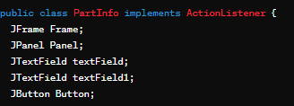
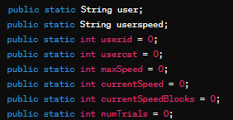
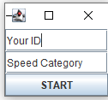
Code Explanation PartInf Class
3. Constructor
public PartInfo():
• Initializes the GUI components and sets up the participant information frame.
• Creates a frame with text fields for ID and speed category, and a button to start the experiment.
• Implements a GridLayout to organize the components.
4. actionPerformed Method
Purpose: Implements the ActionListener interface to handle button clicks.
Implementation :
• Captures participant ID and speed category input.
• Disposes of the input frame.
• Converts input to integers (userid, usercat).
• Initiates experiment-related variables.
• Creates output log file with participant information.
• Calls StartTrail class to start the next trial.
1. Variables
1.1 GUI Components
JFrame Frame:
• Represents the main frame for participant input.
JPanel Panel:
• Container for organizing GUI components.
JTextField textField, JTextField textField1:
• Input fields for participant ID and speed category.
JButton Button:
• Button to initiate the experiment.
1.2 Participant Information
public static String user:
• Stores the participant's ID.
public static String userspeed:
• Stores the participant's selected speed category.
public static int userid, usercat, maxSpeed, currentSpeed, currentSpeedBlocks, numTrials:
• Integer variables to store various participant-related information.
public static String[] sSpeed, sblock, block1, block2, block3, block4:
• String arrays to store information related to speed and trial blocks.

Slide 20
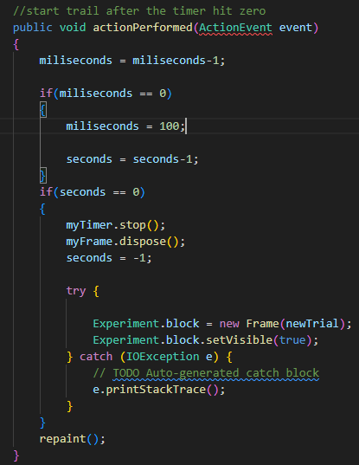
Code Explanation StartTrail Class
1. Constructors
a. public StartTrail(String trial, int seconds)
Purpose: Initializes a timer for a specific trial and displays countdown information.
Implementation:
• Sets up the timer with a specified duration and associates it with the actionPerformed method.
• Creates a JFrame for the timer display.
b. public StartTrail(int block, int seconds)
Purpose: Initializes a timer for the next trial in a block and displays countdown information.
Implementation:
• Sets up the timer with a specified duration and associates it with the actionPerformed method.
• Determines the next trial based on the block and creates a JFrame for the timer display.
2. paint(Graphics g)
Purpose: Displays countdown, current speed, and next trial information.
Implementation:
• Uses the Graphics object to draw the countdown, current speed, and next trial information on the JFrame.
3. actionPerformed(ActionEvent event)
Purpose: Handles timer events, updates the countdown, and triggers the start of the trial.
Implementation:
Decrements the countdown and updates the timer display.
When the countdown reaches zero, stops the timer, disposes of the JFrame, and triggers the start of the trial by creating a new Frame (Experiment block).
actionPerformed function

Slide 21
Code Explanation Trial Class
1. getTrial(String trial)
Purpose: Returns the trial information based on the provided trial code.
Implementation:
• Utilizes a switch statement to map trial codes to specific trial information.
• Trial codes like "T1," "T2," etc., are associated with trial descriptions like "SHR," "SHL," etc.
2. getInfo(String trial)
Purpose: Parses trial information, sets the current speed in PartInfo, and returns the trial description.
Implementation:
• Converts the input trial code into a speed category and trial description.
• Sets the PartInfo.currentSpeed based on the parsed speed.
3. getSpeed(int player)
Purpose: Reads player speed information from a properties file.
Implementation:
Loads player speed information from the "player.properties" file.
Retrieves the speed information for the specified player and returns it.
4. getBlockTrials(String b)
Purpose: Reads and parses the trials order for a given block from a properties file.
Implementation:
Loads trial order information from the "config.properties" file.
Retrieves and returns an array of trial codes for the specified block.
5. getSpeedBlocks(int p, int s)
Purpose: Reads and parses the speed blocks order for a user from a properties file.
Implementation:
Loads speed block information from the "player.properties" file.
Retrieves and returns an array of speed blocks for the specified user and speed category.

Slide 22
Code Explanation Frame Class
1.Variable:
• IDs: Static variable to track the participant IDs.
• flag_block1, flag_block2, flag_block3, flag_block4: Flags indicating the active experimental block.
• ids: ArrayList to store participant IDs.
• path: ArrayList to store the path data.
• time: ArrayList to store time data.
• speed: ArrayList array to store speed data for different speed categories.
• mywatch: Instance of the stopwatch class for timekeeping.
• trial: String to store the current trial information.
• spoint, epoint: Point objects to store the starting and ending points of the mouse movement.
• Coordinates (x1, x2, x3, x4, y1, y2, y3, y4, mx, my): Initial and calculated coordinates for the experiment setup.
2.Constructor - Frame(String s):
Purpose: Initializes the Frame for the experiment based on the trial information.
Implementation:
• Sets initial and modified coordinates based on the trial.
• Initializes the UI through initUI().
3.Method - initUI():
Purpose: Initializes the user interface for the experiment.
Implementation:
• Sets up the JFrame with appropriate dimensions.
• Creates instances of CustomComponent for the starting and finishing lines.
• Adds components to the JFrame.
• Moves the mouse cursor to the designated starting point.
4.Inner Class - CustomMouseListener: (empty class)
Purpose: Handles mouse events for the starting line.
Implementation:
• Starts the timer upon entering the green line.
• Records the starting point upon entering.
5.Inner Class - CustomMouseListenerLabels: (empty class)
Purpose: Handles mouse events for the finishing line.
Implementation:
• Stops the timer and records the ending point upon exiting.
• Manages transitions between experimental blocks and trials.
• Writes time and trial information to the log file.

Slide 23
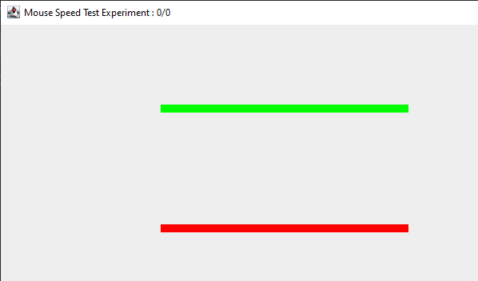
Code Explanation Frame Class
6.Inner Class - CustomComponent:
Purpose: Custom JComponent for drawing the starting and finishing lines.
Implementation:
• Draws the lines with different colors (green for starting and red for finishing).
• Sets up mouse listeners for both lines.
7.Inner Class - TimeComponent:
Purpose: Custom JComponent to display the timer.
Implementation:
• Displays the timer and updates it in real-time during the experiment.
8.Method - calcAvgTime():
Purpose: Calculates and writes the average time and speed information to the log file.
Implementation:
• Calculates average speed for each speed category.
• Calls writeAvgTime() to write the information to the log file.
9.Methods - writeTime(), writeAvgTime(double avg_time, ArrayList<Double> avg_speed):
Purpose: Writes time and average time information to the log file.
Implementation:
• Utilizes PrintWriter to append data to the log file.
10.Method - writeBlockTitle(int num):
Purpose: Writes the block number information to the log file.
Implementation:
• Appends block title information to the log file.

Slide 24
Code Explanation Stopwatch Class
1.Variables:
• miliseconds, seconds, minutes: Integer variables to represent the time in milliseconds, seconds, and minutes, respectively.
• myTimer: Timer object responsible for triggering the actionPerformed method at regular intervals.
2.Constructor - stopwatch():
Purpose: Initializes the stopwatch object and sets up the Timer.
Implementation:
• Initializes the Timer (myTimer) with a delay of 10 milliseconds and sets itself as the ActionListener.
• Starts the Timer with an initial delay of 0.
3.Method - start():
Purpose: Starts or restarts the Timer.
Implementation:
If the Timer is running, resets the time variables (miliseconds, seconds, minutes) and restarts the Timer.
If the Timer is not running, starts the Timer.
4.Method - reset():
Purpose: Resets the Timer and time variables.
Implementation:
• Resets the time variables (miliseconds, seconds, minutes) to zero.
5.Method - stop():
Purpose: Stops the Timer.
Implementation:
• Stops the Timer (myTimer).
6.Method - actionPerformed(ActionEvent event):
Purpose: Handles the Timer's action event, updating the time variables.
Implementation:
• Increments miliseconds by 1 on each Timer tick.
• Resets miliseconds and increments seconds on reaching 100 miliseconds.
• Resets seconds and increments minutes on reaching 60 seconds.

Slide 25
Conclusion and Future Work
.
Future Experimentation
• Device Compatibility: Extend the experiment to devices with specific features such as Leap Motion for finger index tracking and air mouse connectivity.
• Application Enhancement: Develop an application capable of handling various user speeds, accommodating different types of motion.
Advancements in Motion Tracking
• Leap Motion Feature: Utilize finger index tracking to explore different hand motions.
• Air Mouse Connectivity: Experiment with devices that can be connected to an air mouse, expanding the range of motion possibilities.
Application Development
• Crossing and Moving Mouse Application: Create an application designed for users with varying speeds.
• Adaptability: Ensure the application can handle different types of user motions effectively.
Final Thoughts
• The project's success in speed recognition lays the foundation for future advancements.
• Continuous improvement and adaptation to new technologies will contribute to the project's ongoing success.
Conclusion
• In this project, the goal was to develop an algorithm capable of recognizing and predicting the speed of participants based on collected data.
• Despite the initial challenge of not differentiating between the four speeds directly, the algorithm successfully identified each participant's speed.
• Through experiments involving 8 participants, the algorithm achieved an impressive 96% accuracy on the test sets.
Algorithm Performance
• The algorithm employed an 80-20 training-test split.
• The accuracy of 96% indicates the effectiveness of predicting participant speeds.
• Recognition of each participant's four speeds demonstrates the algorithm's capability.
Future Work
• Expanding Speed Categories: Consider adding another speed category to enhance diversity and achieve more accurate results.
• Reducing Break Times: Address participant engagement by decreasing breaks between trials to maintain interest during the 2 hours and 30 minutes.
• Increasing Participant Pool: Involve more participants (6 additional volunteers) to enhance the efficiency and reliability of the experiment

